Slide 1


MACHINE LEARNING PROJECT
PREDICTING THE TOMATOMETER
Rotten Tomatoes Case: A Machine Learning Model for
Fresh vs Rotten Classification
Ana Claudia Russo & Jeronimo Cagliero
Ironhack, Data Analytics Bootcamp - Sep, 2026

Slide 2
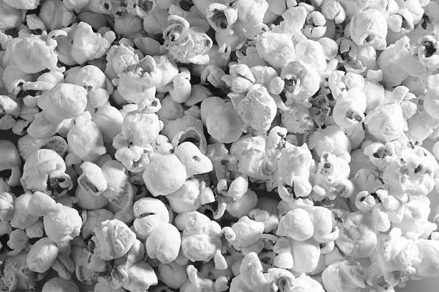
PROJECT OVERVIEW
THE DATASET
THE GOAL
Source: Rotten Tomatoes is website that aggregates movie ratings from critics and audiences worldwide.
Dataset: rotten_tomatoes_movies.csv — title, genre, cast, runtime, audience & critics' scores (scraped Oct 2020).
Goal: Predict whether a movie is Fresh or Rotten using ML, based on metadata and audience/critic signals.
ML problem: binary classification, trained on historical rating patterns.
Why it matters: reveals which factors drive critical reception — valuable for studios, marketing, and streaming platforms.
Notes:
Rotten Tomatoes is a popular website that collects movie ratings from both critics and audiences.
In this project, we use the rotten_tomatoes_movies.csv dataset, which is the most complete and complex file available. It includes detailed information about each movie, such as title, description, genres, cast, runtime, audience score, and critics’ score.
Although the data was scraped over several days in October 2020, the dataset still provides strong and rich information for building Machine Learning models.
This project explores how machine learning can classify movies as Fresh or Rotten based on metadata and aggregated audience/critic information.
The core ML problem addressed is a binary classification task, where the model learns patterns from historical movie data to predict the final rating category.
This project explores how machine learning can classify movies as Fresh or Rotten based on metadata and aggregated audience/critic information.
The core ML problem addressed is a binary classification task, where the model learns patterns from historical movie data to predict the final rating category.

Slide 3

data selection and preparation
RAW DATA
17,712 rows
x 22 columns
FINAL DATASET
8,934 rows
x 10 main columns
filter - categorize - cluster
Original dataset: 17,712 rows × 22 columns.
Filtered by popularity: kept only movies with audience_count > 3,500 reviews.
Categorized high-cardinality features with AI support to define main value groupings.
Applied K-Means clustering to group actors/production companies by: audience rating (weighted avg), audience count, and movie count.
Target column (tomatometer_status) converted to binary: Fresh (≥60% positive critic reviews) vs. Rotten (<60%).
Final dataset: 8,934 rows × 10 main columns.
Notes:
Dataset original com 17712 rows x 22 columns
Once we have a robust data frame, we used “audience_count” column as a popularity indicator and keep only the rows with more than 3500 reviews
For the columns selected as features, we applied some categorization and clustering process, to turn the data ready for Machine Learning assembles
For categorization, due the big number of values per raw, we used AI support to help to define main values on the classification
For the clustering, K-Means was used to group actors based on three variables:
Audience Rating: weighted average audience rating across their movies.
Audience Count: total number of audience ratings accumulated by their movies.
Movie Count: number of unique movies associated with each production company.
For the target column, “tomatometer_status”, we transform the column to a binary classification, where:
# Fresh: A film with 60% or more positive reviews from critics
# Rotten: A film with less than 60% positive reviews from critics
After all the preparation, we defined our final dataframe with 8934 rows and 10 main columns

Slide 4

feature engineering and selection
Feature Engineering Process
Applied Train/Test Split with stratification to preserve class balance before any transformation.
Converted all categorical variables using One‑Hot Encoding, ensuring consistent dummy columns across train and test sets.
Normalized numerical features (e.g., runtime) using MinMaxScaler to improve model stability.
Reindexed the test set to match training feature columns, preventing feature mismatch errors during prediction.
Feature Selection Approach
Removed non‑predictive or leakage‑prone columns (e.g., movie_title).
Selected features based on domain relevance (metadata, genres, clusters, release information).
Ensured all engineered features aligned with the model’s expected input structure.

Slide 5
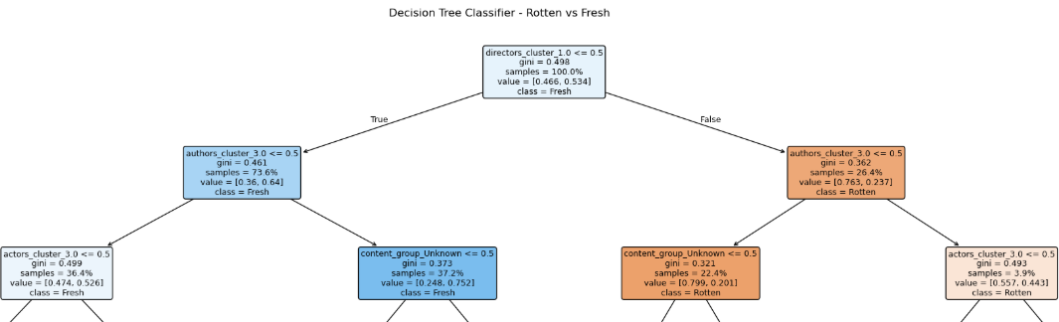
DECISION TREE | FEATURE validation
A Decision Tree Classifier was used to validate which features best separate Fresh from Rotten movies
Root split (directors_cluster) confirms clustering features are the strongest early predictors
authors_cluster, actors_cluster, and content_group follow as key splits — reinforcing the feature engineering choices
Genre and runtime refine predictions within subgroups, but carry less weight than the clustering features.
Notes:
Decision Tree — Feature Exploration (Rotten vs. Fresh)
Before testing other ML models, a Decision Tree Classifier was applied to explore which features best separate Fresh from Rotten movies.
Root split: directors_cluster — the single strongest early predictor, separating the dataset almost evenly (46.6% Rotten / 53.4% Fresh).
Subsequent key splits: authors_cluster, actors_cluster, and content_group (Unknown), showing that cast/crew clustering features carry strong predictive power.
Genre-specific splits (e.g., Drama, Family, Sci-Fi) and runtime appear deeper in the tree, refining predictions within specific subgroups.
streaming_release_date also emerged as a relevant split, suggesting release timing has some influence on ratings.
The tree confirms that clustering-based features (directors, authors, actors) are the most informative for classification — validating the feature engineering approach used earlier.

Slide 6
model building and evaluation
We tested three models — Random Forest, XGBoost, and a manually tuned XGBoost — to compare their performance and identify the most effective approach. Each model delivered different results, helping us understand which one generalized best.
Random Forest Classifier
Strong performance on training data (83.75%) but significant drop on test (73.65%) → clear overfitting.
Useful as a baseline ensemble model, but not ideal for generalization.
XGBoost – Original Configuration
Good initial accuracy (~72–73%) but noticeable overfitting (train ≈ 80%).
Served as a foundation to understand how boosting behaves with the dataset.
XGBoost – Manually Tuning
Delivery higher test accuracy (74.37%), balanced precision/recall, and minimal overfitting, making it the most reliable model for predicting Fresh vs Rotten.

Slide 7
model building and evaluation
The manually tuned XGBoost model was selected as the final model after refining its hyperparameters using insights from Random Search and additional manual experimentation.
Key adjustments included:
max_depth = 3 → best generalization
learning_rate = 0.1 and n_estimators = 300 → stable learning
subsample = 0.8 and colsample_bytree = 0.8 → reduced variance
Regularization (reg_alpha, reg_lambda) → controlled complexity
Achieved the best overall performance:
Test Accuracy: 0.7437
Balanced precision, recall, and F1 across both classes
Minimal gap between train and test → no overfitting

Slide 8
KEY FINDINGS AND INSIGHTS
The Manually Tuned XGBoost model achieved the best balance between accuracy, stability, and generalization, outperforming all other tested models.
Careful hyperparameter tuning — combining automated search with manual refinement — was essential to reach optimal performance.
The final model demonstrates that structured metadata (genres, clusters, release info) can effectively predict movie ratings.
It’s a primary model to understand the behauviour, later can be improved regression model, but probably need more info.

Slide 9
REAL-WORLD APPLICATION & IMPACT
The model can help streaming platforms and studios predict audience reception before release, supporting smarter content acquisition and marketing decisions.
It provides data‑driven insights that reduce financial risk and improve recommendation quality.
Ethical considerations include potential bias reinforcement, limited understanding of creative factors, and the need for continuous updates as audience preferences evolve.
previsiones para clasificar las peliculas antes de su estreia
Notes:
How the Model Can Be Applied
The final XGBoost model can support content strategy decisions for streaming platforms by predicting whether a movie is likely to be Fresh or Rotten before release.
Studios and marketing teams can use these predictions to optimize promotional investment, target audiences, and adjust release timing.
Platforms can leverage the model to prioritize acquisitions, selecting movies with higher predicted audience approval.
The model demonstrates how structured metadata (genres, clusters, release info) can be transformed into actionable insights for entertainment analytics.
Potential Impact
Helps reduce financial risk by offering early performance expectations.
Supports data‑driven decision‑making, replacing intuition‑based choices with measurable predictions.
Enhances user experience by enabling platforms to recommend higher‑quality content more effectively.
Ethical Considerations & Limitations
Predictions rely on historical patterns and may reinforce existing industry biases (e.g., genre stereotypes, production company influence).
The model does not account for creative factors such as script quality, acting performance, or cultural trends.
Risk of misinterpretation: predictions should guide decisions, not replace human judgment.
Requires continuous updates to remain relevant as audience preferences evolve.

Slide 10
CHALLENGES & LEARNINGS
Normalized the DataFrame for ensemble methods, ensuring consistent scaling for algorithms sensitive to feature magnitude.
Managed high‑dimensional dummy variables while maintaining model interpretability and avoiding sparse‑feature issues.
Addressed feature mismatch errors during prediction by enforcing strict column alignment between train and test sets.
Balanced preprocessing steps to avoid data leakage and ensure robust generalization.
Handled overfitting across multiple models, learning how hyperparameters (max_depth, subsample, regularization) impact generalization.
Faced instability during Random Search, discovering that automated tuning can produce noisy or overfitted configurations.

Slide 11
thank you!
Rotten Tomatoes: A Machine Learning Model for
Fresh vs Rotten Classification
Ana Claudia Russo & Jeronimo Cagliero
Ironhack, Data Analytics Bootcamp - Sep, 2026

